Slide 1
Smerdis technologies, LLC.
Modular Mobile Platform Solutions
By:
Bardia Mojra, Shashi Nagendra, Reshma Titus
Notes:
Bardia
Introduce the team
Today we are introducing a better solution for mobile robots industry that will benefit everyone from current manufactures to our future investors
To reshma

Slide 2
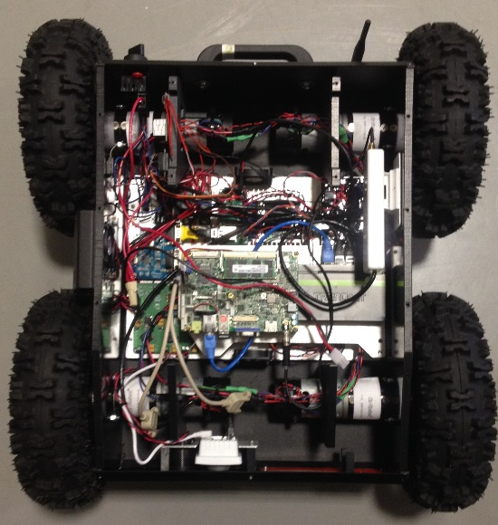
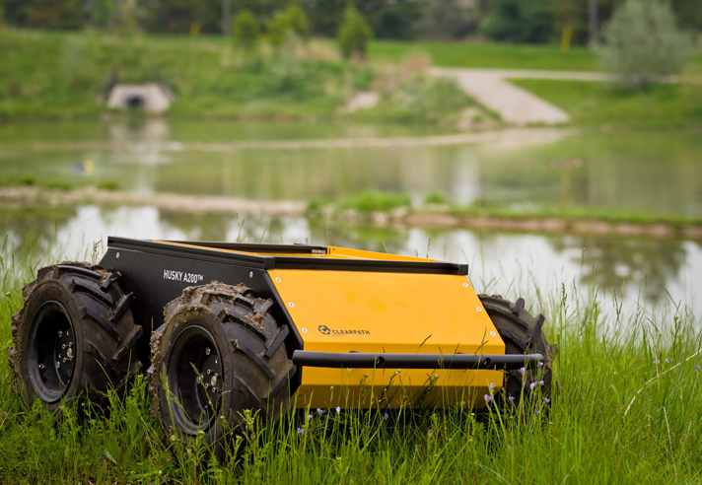
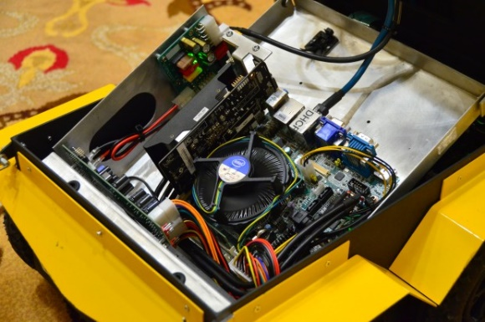
Problem
Jaguar 4x4, $7,000
Very expensive
Big and bulky
Low performance
No on-board computer
No standard control node
Difficult to troubleshoot and repair
Husky, $40,000
Jackal, $10,000
Source: http://www.clearpathrobotics.com/husky/
http://www.clearpathrobotics.com/jackal/
Notes:
Reshma
Whats wrong with the market
In R&D every minute counts and we need rapid testing
Needs to be charged all the time
Hard integration makes it time consuming and fragile
Different integration for each platform

Slide 3
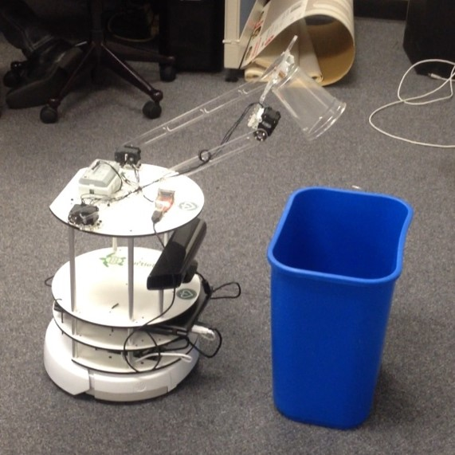
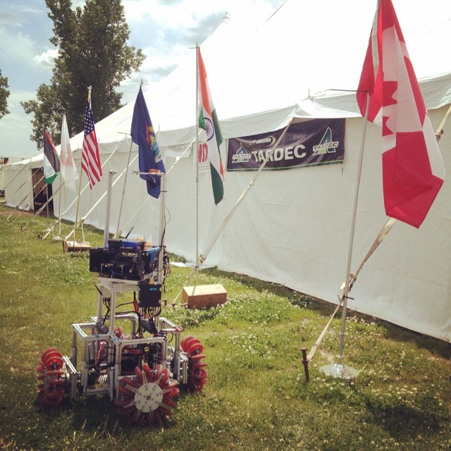
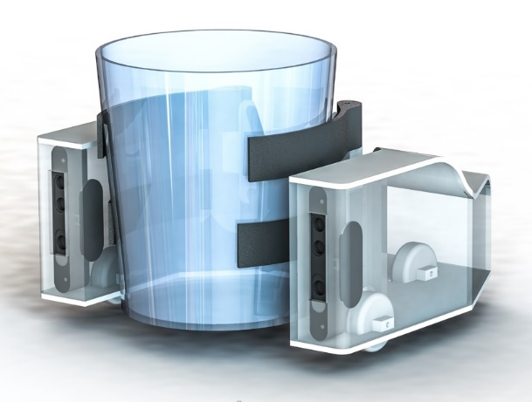
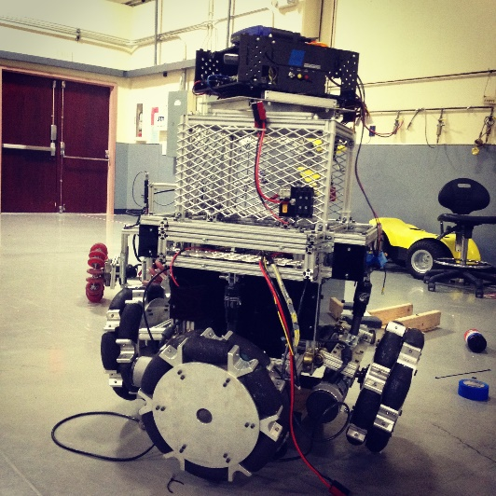
Solution
HomeBot Series | Viking Series
Two affordable platforms
HomeBot series (less than $1k)
Viking series (less than $3k)
High resolution feedback
Robust electronics
Compatible with major IEEE standards
Designed specifically to be extensible and modular
Notes:
Reshma
2 solution for 2 different categories
1- domestic and consumer application – HomeBot
2- Outdoor and industrial application – Viking series
Major ieee standard: wifi, Ethernet, rs232 over UART
Feedback – IMU, GPS, Depth camera, wheel encoder, 360 lidar

Slide 4
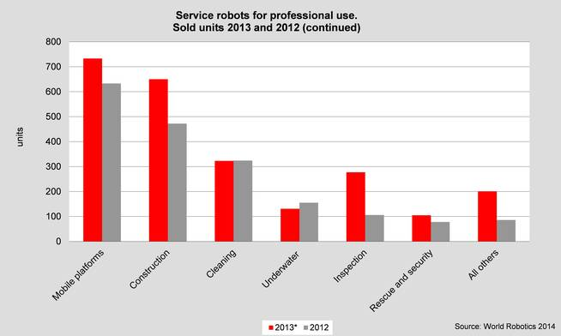
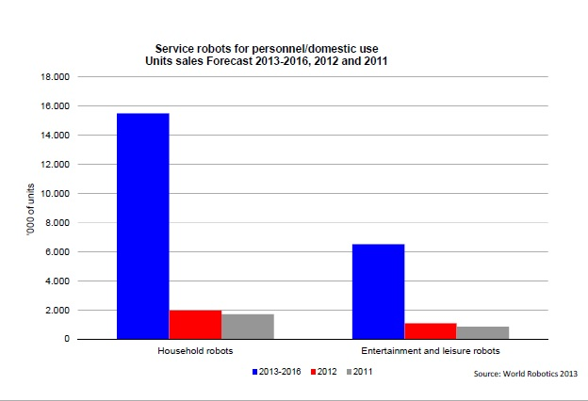
Opportunity & target market
Highest market projections for mobile robots:
Domestic robots
Commercial robots
Military platforms
Agriculture service robots
Affordable and reliable solution for:
Universities and high schools
Mobile robot application manufactures
Opportunity:
Supplying core technology for cheaper, better performance to current manufacturers
sell our robotic platforms to end users to create cash flow
Source: http://www.ifr.org/service-robots/statistics/
Notes:
Reshma
Opportunity: supplying core technology for cheaper, better performance to current manufacturers
also to sell our robotic platforms to end users to create cash flow

Slide 5
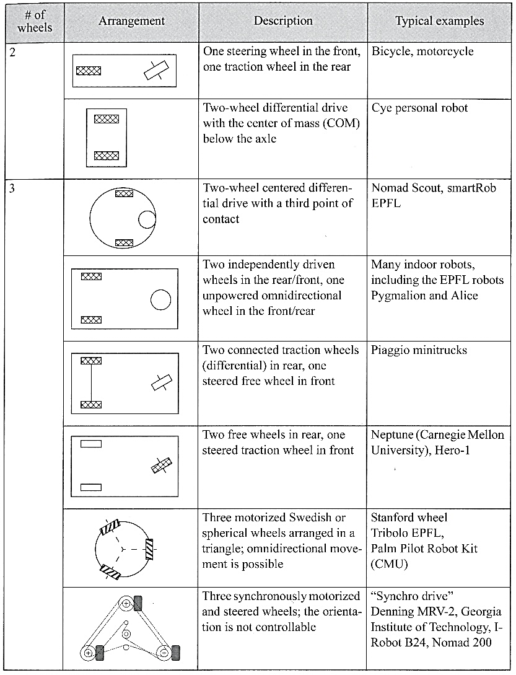
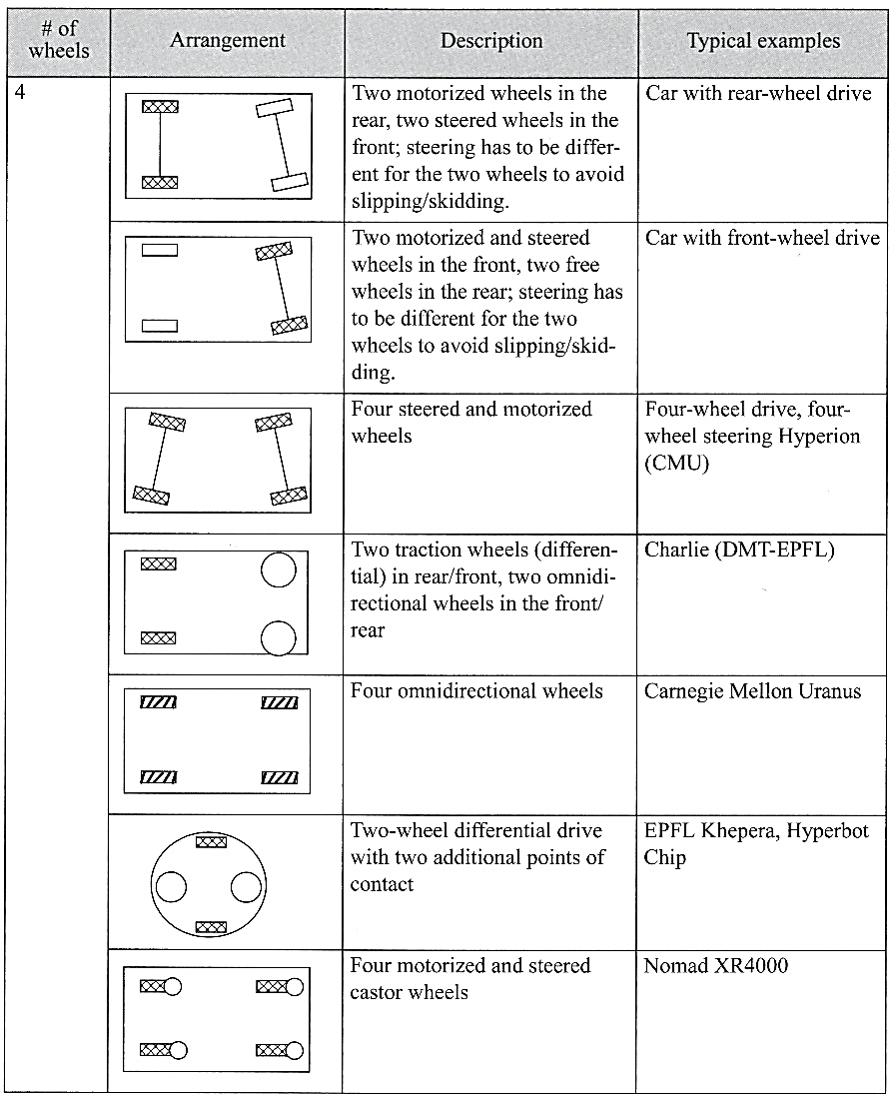
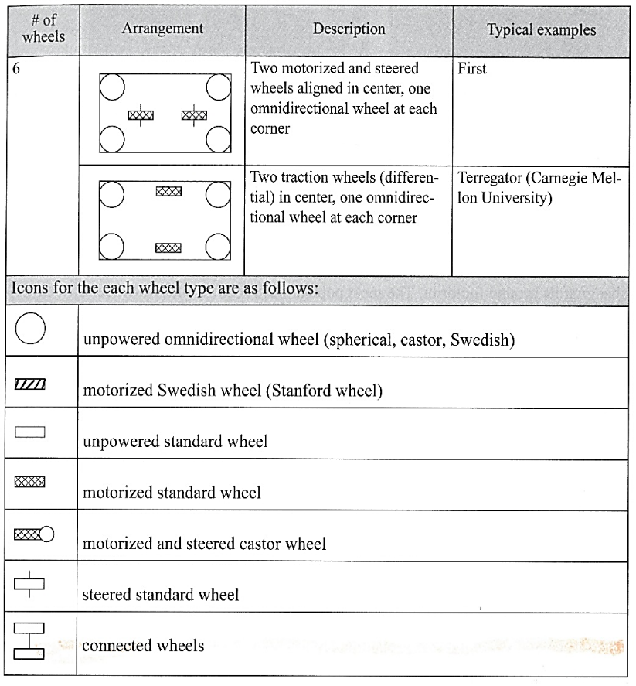
UGV Market
Source: Autonomous Mobile Robots, The MIT Press
Notes:
bardia

Slide 6
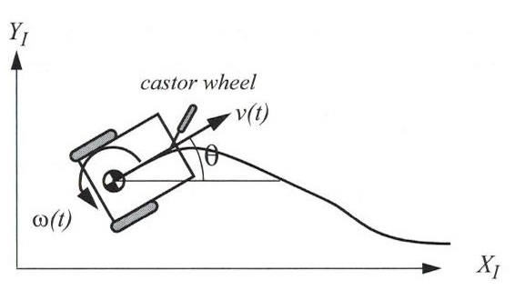
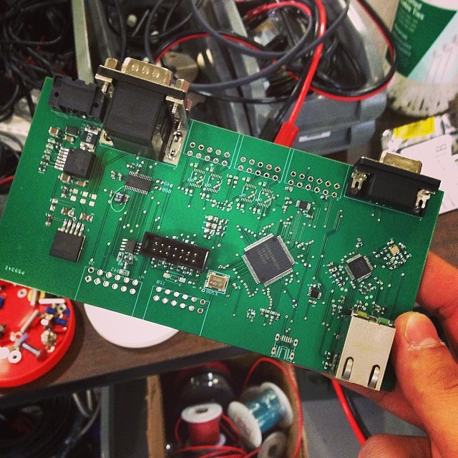
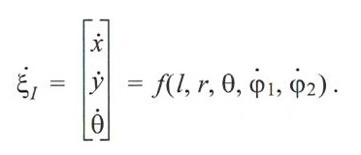
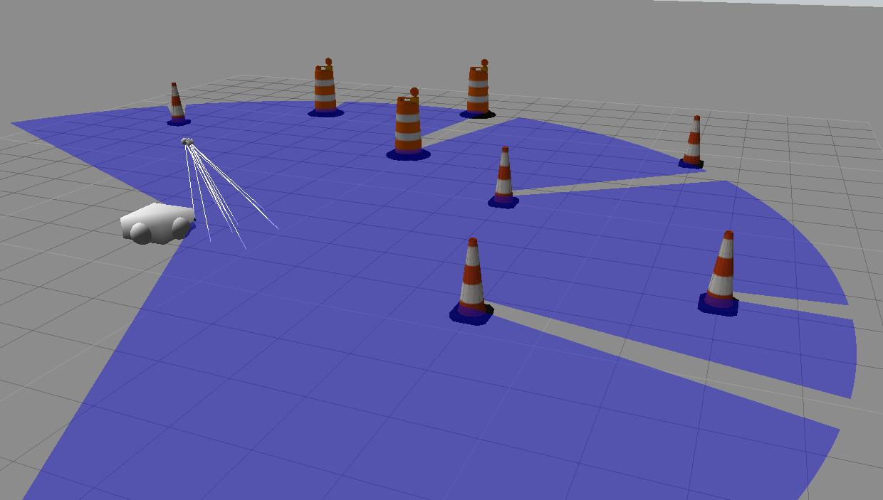
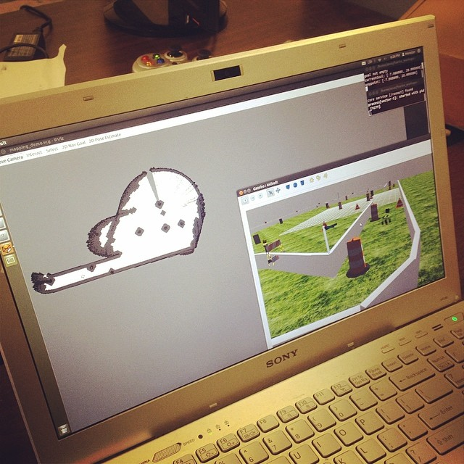
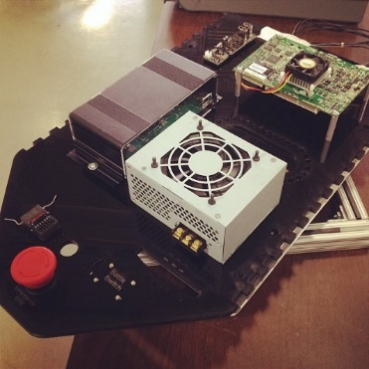
Core Technology
Smerdis Vehicle Control Unit (VCU) technology
Twist message velocity input (x, y, theta)
Ethernet, UART and RS232 serial wired interfaces
Wireless control over PlayStation controller, ZigBee, and Wifi
Control over IP
Modular
On-board computer
Autonomous navigation using SLAM
Mapping and line detection
Robot Operating System (ROS) ready
Sensor feedback ready
Notes:
Bardia
change this

Slide 7
competition
Company | Clearpath Robotics | Dr. Robot | Robotnik | Smerdis Technologies | Smerdis Technologies
Platform | Jackal | Jaguar 4x4 | Guardian | Viking Series | HomeBot Series
Price | $10k | $7k | $12k | $3k | $1.5k
Comparison | Hard to control Bulky Not modular Expensive | Bad odometer feedback Fragile Difficult to repair Low quality camera expensive | Low operation time heavy and bulky hard to integrate no feedback expensive | Up to 600 lb. payload Long battery life Extensibility & Modularity On board computer Licensable hardware and software | Up to 50 lb. payload Cooperative agents technology Smart home compatible Open source software Licensable hardware
Notes:
Shashi
Cheaper and better technology
Other sale one platform for both indoor and outdoor
We have separated the two so we can provide a better solution for each application

Slide 8
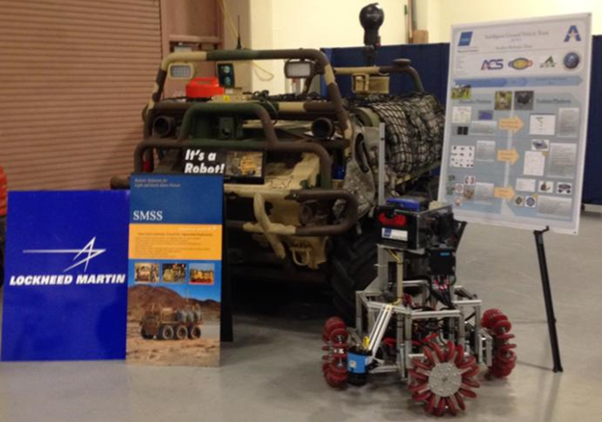
Marketing & sales
Marketing strategy
AUVSI and IEEE publications
Events:
International Conference on Robotics& Automation (ICRA)
UAVSI’s Unmanned Systems Expo
Robotics Alley Conference and Expo
Social media and email newsletters
Sales through partners:
Lockheed Martin: Missiles and Fire Control
Smart home companies
Commercial service robot manufacturers
Direct sales:
Universities and high schools
Research and development centers
Notes:
Shashi
AUVSI and IEEE publication targeting scholars and researchers
Events, to showcase to commercial and industrial customers
Social media and emails for public view and establishment
Smart home companies for domestic robots

Slide 9
Management team
Structure:
CEO & Director of Marketing: Bardia Mojra
CFO & Director of Sales: Shashi Nagendra
CTO & Director of Operations: Reshma Titus
6 years of combined experience in UGV research & development
2 published papers
2 pending patents
Notes:
Shashi
Patents will protect our technology and enable us to license it other companies

Slide 10
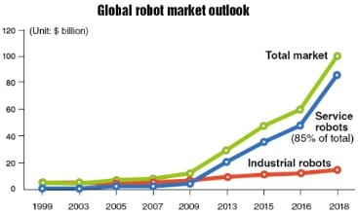
Financial projections
$85B market projection for service robots in 2018
Low margin strategy at 30%
0.3% market share by 2018 (low estimation)
Estimated sales $255M
Estimated revenue $76.5M
Estimated company evaluation $765M
Source: http://www.koreaherald.com/view.php?ud=20110118000723
Notes:
Shashi
Market projection
Low-margin-large-market-share strategy to establish our VCU technology as a market standard and core hardware (main sales)
Our platforms are to prove our technology and also sale

Slide 11







Current Status
Testing & troubleshooting phase:
VCU: 1 year of testing with 100% success rate
Viking series: beta stage testing for 2nd prototype
HomeBot series: 1st prototype testing, 5th iteration design completed
Achievements:
Placed 12th internationally at Intelligent Ground Vehicles Competition (IGVC) in 2013 and 15th in 2014
Multiple federal research grants
Partners & Sponsors:
UTA Research Institute
Advanced Control & Sensors Group (ACS)
Operation Finally Home
Lockheed Martin: Missiles & Fire Control
Office of Naval Research (ONR)
Tank Automotive Research Development & Engineering Center (TARDEC)
Air Force Office of Scientific Research (AFOSR)
Notes:
Bardia

Slide 12
Financial Sought
Seeking investment from:
Mobile robot manufacturers
Venture capitalists with tech and robotic background
Other potential industrial and commercial customers
Seeking investment:
$2M for extensive beta phase testing
$5M for marketing and expo showcasing
$8M for manufacturing
$15M total for 15%
7.65 times return on stake after 4 years
Notes:
Bardia

Slide 13
Summary
Superior solution at lower cost
Reliable sales strategy by supplying to both:
Current manufactures to lower their development cost
End users to secure cash flow
Established partnership and accredited team
High return even at low estimate and low margin
Notes:
Bardia

Slide 14
Thank you!
Questions

